Slide 1
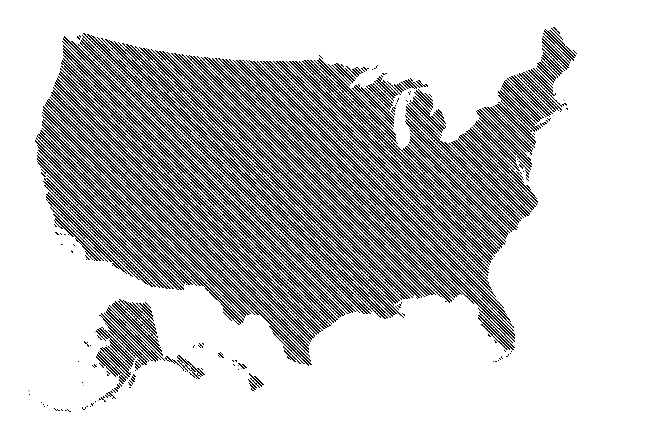




MMMMM TITLE GOOOD
Data collection
Expansion Status, Heart Disease, Insurance Coverage
Covariates
Preliminary Analysis
Mapping Heart Disease & Insurance
Comparison by Grouping
Social Factor Comparisons
National Causal Effect Analysis
Two-stage Difference-in-Difference Regression
Two-stage DID Grouped by Initial Insurance Coverage
Adjacent Cohorts Analysis
Preliminary Analysis: Plots & Maps
Regional Causal Effect Analysis
w/ Synthetic Difference-in-Difference

